Slide 1

Welcome to
TAलाSH A Face Recognition & Alert System

Slide 2
Introduction
TAलाSH is an autonomous system that helps Investigating Authorities in finding criminals/missing person.
We are using advance ML based models to compare the faces captured by Cameras in live video feeds with the database.
Officials will be informed immediately through SMS and E-mails as soon as any person is identified.

Slide 3





Flow Diagram
Admin (User)
E-Mail & Phone No. Verification of User
Face Detection Starts
User Authentication
Face is feed in the database
If face matches, then alerts will be sent
Objective
Achieved

Slide 4
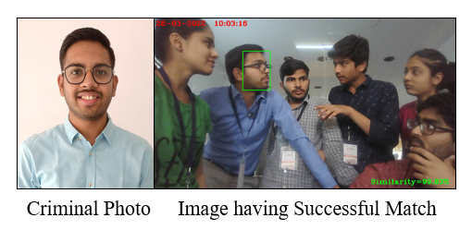
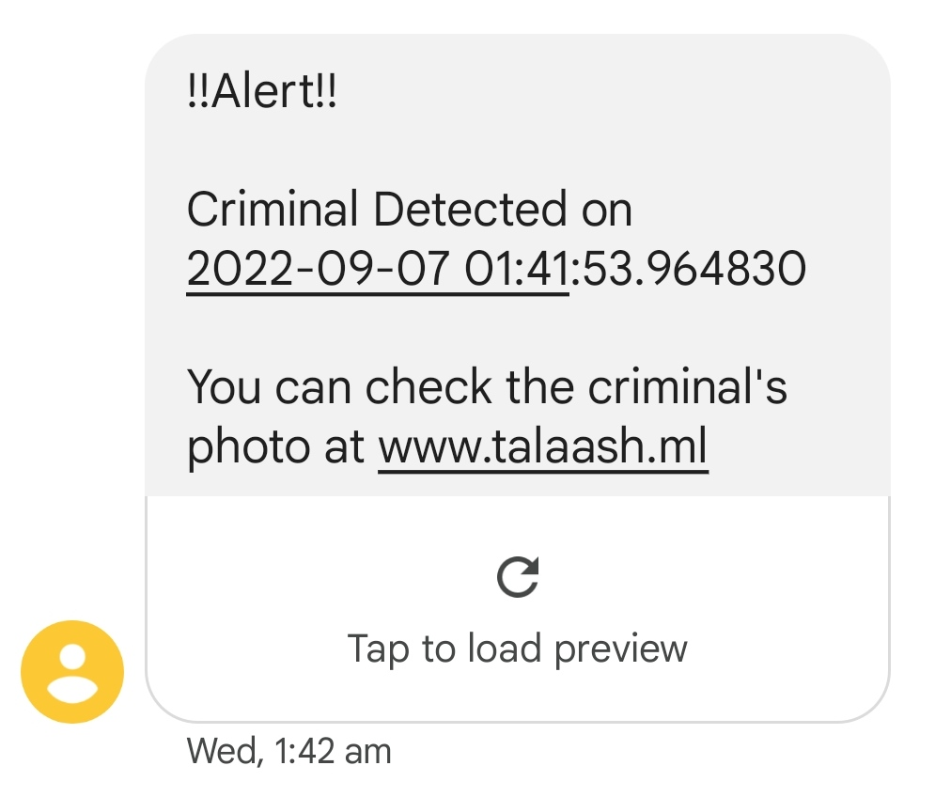
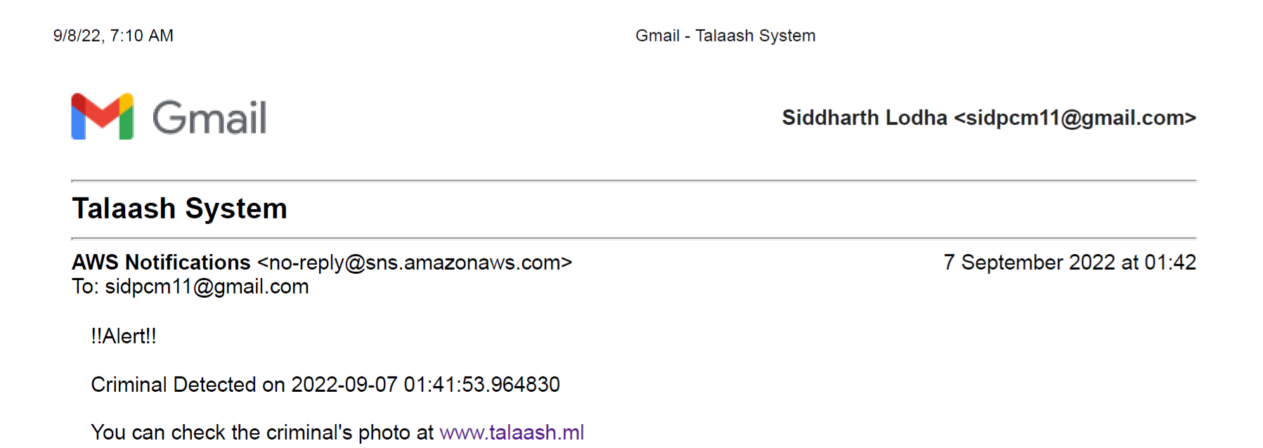
Results/
Outcomes

Slide 5
Key Features
System can compare faces even in a crowded area with high accuracy.
Notifies when there is a successful face match along with the date, time, and location.
This whole system can work 24*7 without any human interference.
It can also detect any weapon or a sharp object possessed by the criminal.

Slide 6
Future Scope & Area of Improvement
With the help of advancement in ML models, this application can be used to detect any ongoing crime or any mishappening & will instantly inform the concerned authorities to minimize the damage.
Video of the criminal/incident can also be provided if needed.
It can be integrated with the alarm system so that the public gets alert in case of any fire or attack.

